Slide 1
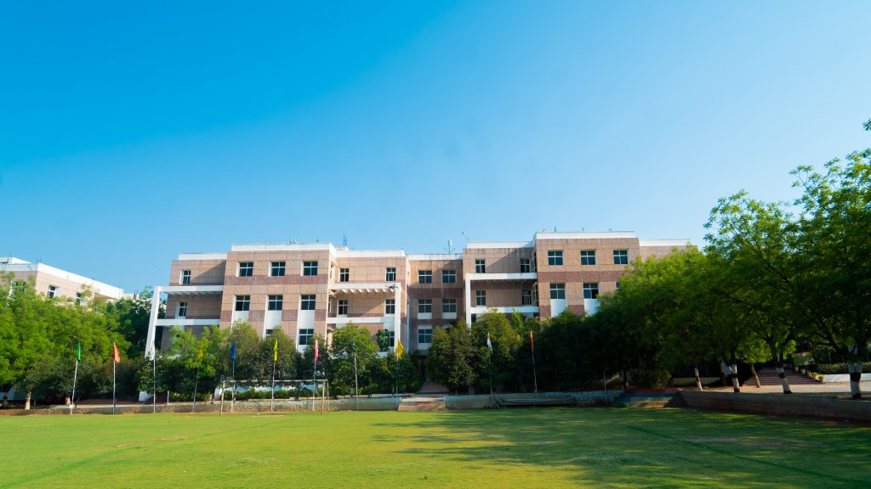

A MINI PROJECT
On
Ingredients Identification from the Food Image Using Deep Learning
Techniques
BACHELOR OF TECHNOLOGY
IN
CSE- DATA SCIENCE
BY
22VE1A67A5 - RAJULAPATI SAI LAKSHMI
22VE1A67A8 - ROYALA TEJASIWINI
22VE1A67B2 - SAMALA RAKSHITH BABU
22VE1A67C6 - VYDYAM KEERTHI CHAKRA
Under the Guidance of
Mrs.G JYOTHI - ASSISTANT PROFESSOR
ACADEMIC BATCH: (2024-2025)

Slide 2
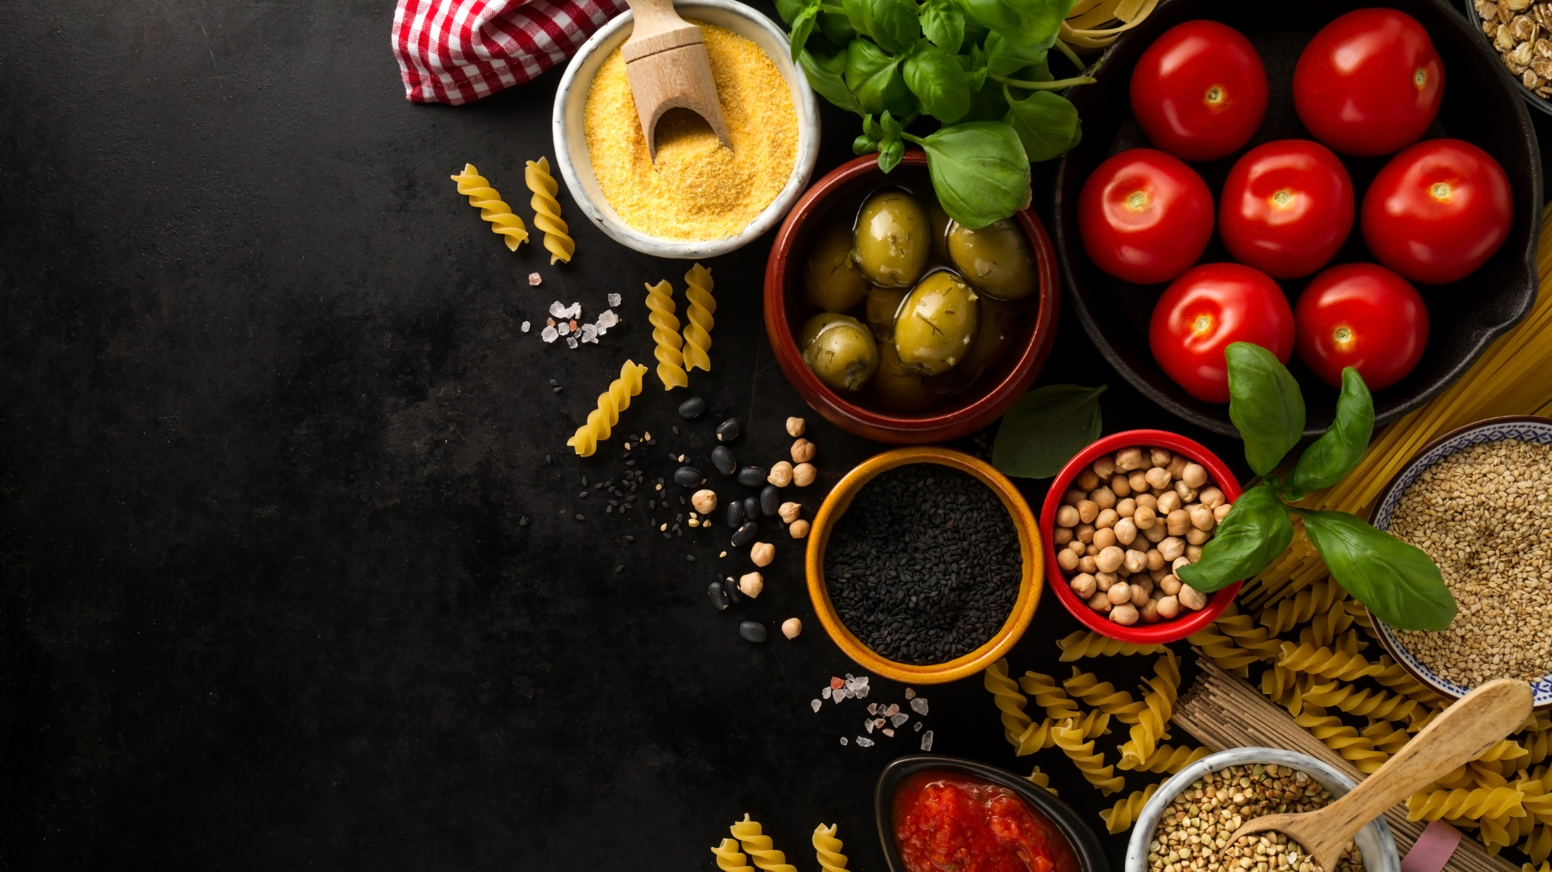
Recipe Generation and Nutritional Analysis from Food Images Using Deep Learning Techniques
CONTENTS :
Abstract
Introduction
Literature Survey
Problem Statement
Existing System
Disadvantages
Proposed System
Advantages
Software & Hardware
Use case Diagram
Activity Diagram
System Architecture
Expected Output
Conclusion
Future Work
References

Slide 3
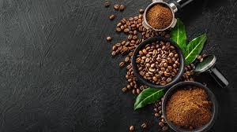
ABSTRACT
Food ingredient identification from images is an essential task in food technology, dietary monitoring, and health-conscious applications. This study proposes a deep learning-based approach for automatically identifying ingredients from food images using the VGG16 convolutional neural network (CNN). The model is trained on a large-scale dataset containing [mention number] food images, covering diverse cuisines and ingredients. The dataset was collected from [mention sources, e.g., open-source datasets, web scraping, custom image labelling etc.] and pre-processed through image augmentation, normalization, and resizing to enhance classification accuracy.Our trained VGG16 model achieves an accuracy of [mention accuracy, e.g., 85-95%] on the test dataset, demonstrating its effectiveness in recognizing multiple ingredients from complex food images. The system is further enhanced by integrating the Groq API, which provides real-time ingredient analysis and detailed nutritional information. This integration allows users to obtain insights into calorie content, macronutrients, and dietary recommendations based on the detected ingredients.
Keywords:
Food ingredient identification, deep learning, VGG16, convolutional neural network (CNN), Groq API, food classification, nutrition analysis, dietary monitoring, image recognition, transfer learning, multi-label classification, object detection, food computing.

Slide 4
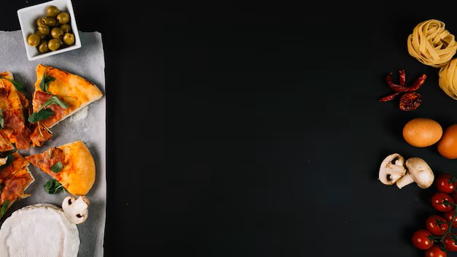
INTRODUCTION
Identifying ingredients in food images is a challenging yet valuable task in areas like health monitoring, dietary tracking, and personalized nutrition. While traditional systems focus on recognizing the dish as a whole, they often ignore the specific ingredients — which are crucial for calorie estimation, allergy detection, and meal planning.
This project focuses on using deep learning to build a system that can automatically identify multiple ingredients from a single food image. Unlike basic classification, this involves multi-label prediction, since one dish can contain many ingredients. The system will leverage advanced neural networks and attention mechanisms to handle the complexity of mixed, hidden, and visually similar ingredients, aiming for high accuracy and real-world usability in smart food applications.

Slide 5
Literature survey:
Fahad Ashiq, Muhammad Asif, Maaz Bin Ahmad, Sadia Zafar, Khalid Masood, Ik Hyun Lee, (2022) - “CNN-Based Object Recognition and Tracking System to Assist Visually Impaired People” :
The paper proposes a system that utilizes Convolutional Neural Networks (CNNs), which are a type of deep learning model commonly used for computer vision tasks such as object recognition and tracking.
Mogan Gim, Donghee Choi, Jihun Choi, Hajung Kim and Jaewoo Kang(CIKM 2022) – “Recipe Mind: Guiding Ingredient Choices from Food Pairing to Recipe Completion using Cascaded Set Transformer” :
The paper aims to develop a tool that would help in pairing various ingredients from different cuisines and suggest an alternate ingredient. The goal is to support the creation of novel recipes and, by suggesting substitute ingredients, assist those who are allergic to particular ingredients.

Slide 6
Gusti Pangestu, Afif Supianto, and Fitri Utaminingrum (2018) – “Food Recipe Finder Mobile Applications Based On Similarity Of Materials” :
The application utilizes content-based filtering techniques, specifically Term Frequency-Inverse Document Frequency (TF-IDF) and Cosine Similarity, to recommend recipes that match the user's input ingredients.
M.S. Rojas, F. Ferrer, and A. Orozco (2023) – “RecipeIS—Recipe Recommendation System Based on Recognition of Food Ingredients” :
RecipeIS utilizes a ResNet-50 convolutional neural network model to recognize food ingredients from images. The model was trained on a dataset containing 36 classes of fruits and vegetables. Upon recognizing an ingredient, the system employs the Edamam API to retrieve and display relevant recipes, including nutritional information and cooking instructions

Slide 7

PROBLEM STATEMENT
1.Multi-Label Ingredient Detection from Food Images
This project aims to address this gap by developing a deep learning model that can perform multi-label classification to detect multiple ingredients from a single image of a food item, enabling more personalized and health-conscious dietary applications.
2.Fine-Grained Ingredient Recognition for Personalized Nutrition
Existing food recognition systems lack the ability to accurately detect the specific ingredients in a dish, which is crucial for applications like nutrition tracking, allergy prevention, and dietary planning.
3.Visual Ingredient Analysis for Health-Aware Food Logging
This project develops a deep learning-based visual recognition system capable of identifying each ingredient present in a food item from an image, enabling more detailed health monitoring and caloric estimation.

Slide 8
EXISTING SYSTEM :
The existing system refers to the current system, process, or technology being used in an organization or context. It's the present setup, which may have its limitations, inefficiencies, or drawbacks.
1. Dish-Level Classification Models :
Traditional systems like those trained on Food-101 or UEC-Food100 datasets focus on dish recognition, not ingredients.
Challenge: One class per image (e.g., “Spaghetti Carbonara”) — no breakdown of ingredients.
2. Recipe-Based Retrieval Systems (e.g., Recipe1M) :
Systems like im2recipe use multi-modal learning (image + recipe text) to retrieve similar recipes.
Limitation: Doesn't explicitly identify ingredients; instead, it retrieves a recipe that likely contains similar ingredients.
3. Weakly-Supervised Ingredient Tagging :
Some models are trained to predict ingredients using image-level labels without bounding boxes or masks.
Challenge: Ingredient co-occurrence biases, and poor handling of visually hidden ingredients.

Slide 9

DISADVANTAGES OF EXISTING SYSTEM
Many people struggle to identify food ingredients due to dietary restrictions, allergies, or a lack of knowledge.​
Language Barriers – Travelers or immigrants may struggle to understand ingredient lists in a foreign language, increasing the risk of consuming something they want to avoid.​
Health & Fitness Consciousness – People following specific diets (e.g., keto, low-carb, sugar-free) need clear information to track their intake properly.​
Health-conscious individuals, people with food allergies, nutritionists and restaurants.​
Misidentification of ingredients can lead to allergic reactions, poor diet choices, and inaccurate nutritional tracking.​

Slide 10
PROPOSED SYSTEM :
The proposed system, on the other hand, is a new or improved system, process, or technology that is being suggested or recommended to replace or enhance the existing system. The proposed system aims to address the limitations and inefficiencies of the existing system, offering improvements, benefits, or advantages.
1. Multi-Label Ingredient Classification :
Use modern CNN or transformer-based architectures (like EfficientNet, ViT, or Swin Transformer).
Final output layer with sigmoid activation to handle multiple ingredient labels per image.
2. Ingredient Attention Mechanism :
Implement an attention mechanism to focus on regions where ingredients are more likely to be visible.
Helps in identifying partially occluded or small-sized ingredients.
3. Real-World Integration :
Can be integrated into:
  Fitness and health apps
  Calorie estimation systems
  Food delivery apps for allergy/diet-based filtering

Slide 11

TECHNICAL REQUIREMENTS :
1. Hardware Requirements :
Processor : Minimum Intel i5 or equivalent (recommended i7 or higher for training)
RAM: At least 8GB (16GB+ recommended)
Storage : Minimum 10GB free space (for model, images, logs)
GPU (optional but recommended): NVIDIA GPU with CUDA support (for training)
2. Software Requirements :
➤ Backend & Frameworks
Python 3.7+
Flask – for web server and routing
Keras / TensorFlow – for loading and using the VGG16 model
NumPy, Pillow (PIL) – for image processing
Groq Python SDK – to connect to the Groq API

Slide 12
TECHNICAL REQUIREMENTS :
3. External Services :
Groq API Access :
Requires an API key
Used to fetch ingredients and nutritional info via LLM (e.g., LLaMA 3)
4. Model Requirements :
Pretrained Model : VGG16 trained on the Food-101 dataset
Model Files : vgg16_food101_trained.h5 (Or) v8_vgg16_model_1.h5 (used in training phase)
Image Size : 224x224 pixels
Output Classes : 101 food categories

Slide 13
TECHNICAL REQUIREMENTS :
5. Deployment Requirements :
Local Deployment :
Run using python app.py
Make sure debug = True only for development
Production Deployment (optional):
Host using services like Heroku, AWS, Render, or DigitalOcean
Use a production - ready WSGI server like Gunicorn

Slide 14
FUNCTIONAL REQUIREMENTS :
1. Input Functionality :
Accepts a food image from the user (upload or camera)
Validates the format (e.g., JPG, PNG)
2. Ingredient Prediction :
Uses a deep learning model to:
  Analyze the image
  Predict the set of ingredients present
  Return a list of ingredients with confidence scores
3. Multi-label Handling :
Supports prediction of multiple ingredients per image
Handles partial visibility and overlapping items

Slide 15
FUNCTIONAL REQUIREMENTS :
4. Result Display :
Shows predicted ingredients on screen
Optionally displays:
  Confidence score for each ingredient
  Ingredient highlights using heatmaps (e.g., Grad-CAM)
5. Performance Metrics Output :
Outputs evaluation results like:
  Precision, Recall, F1 Score
  Hamming Loss, Coverage Error
6. Optional Features :
User interface for uploading images
Calorie estimation based on predicted ingredients
Download or save predictions

Slide 16
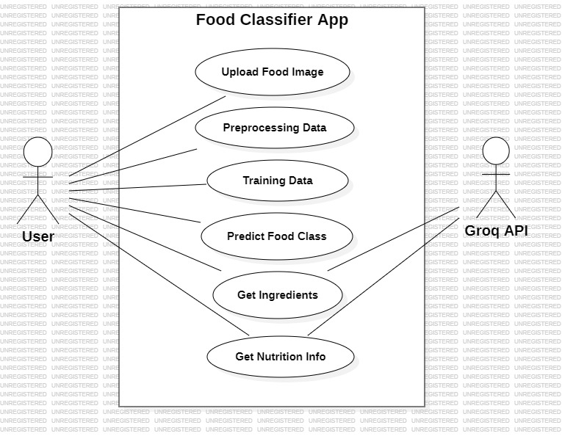
DESIGN : USE CASE DIAGRAM

Slide 17
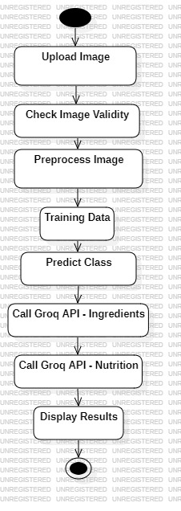
ACTIVITY DIAGRAM :

Slide 18
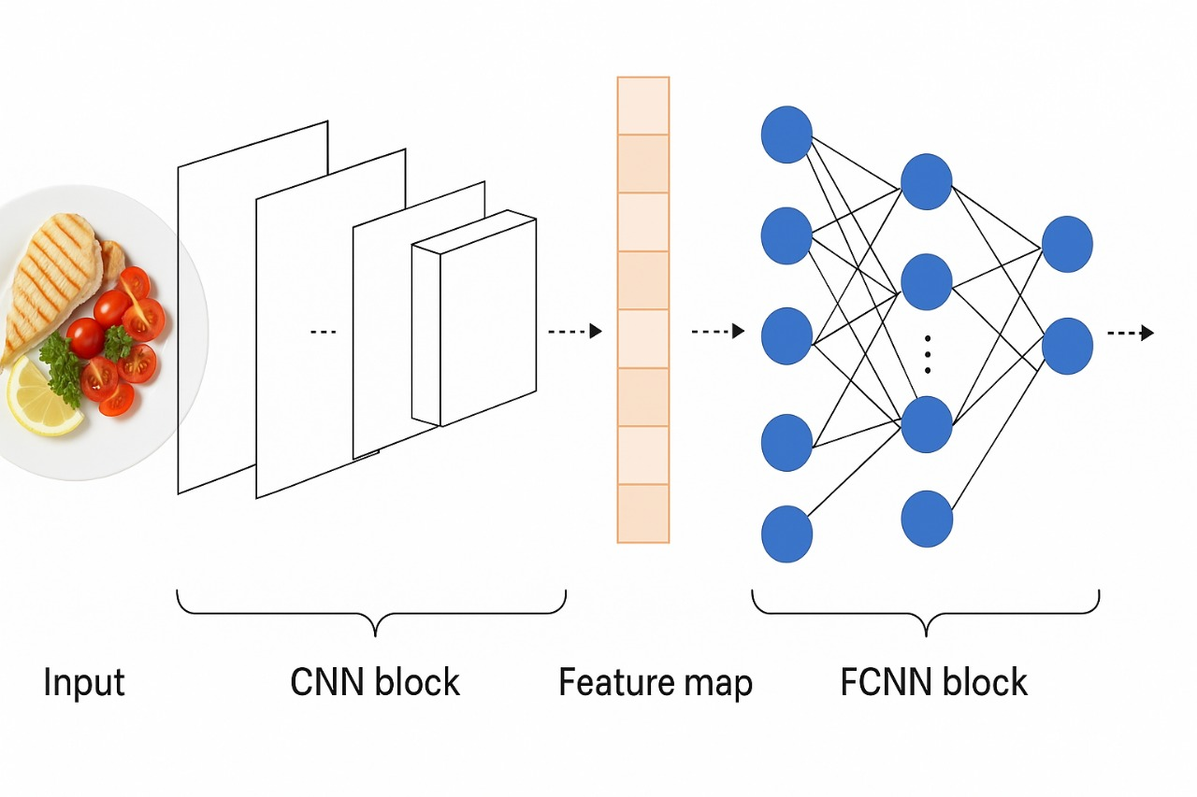
ARCHITECHTURE :
Output

Slide 19
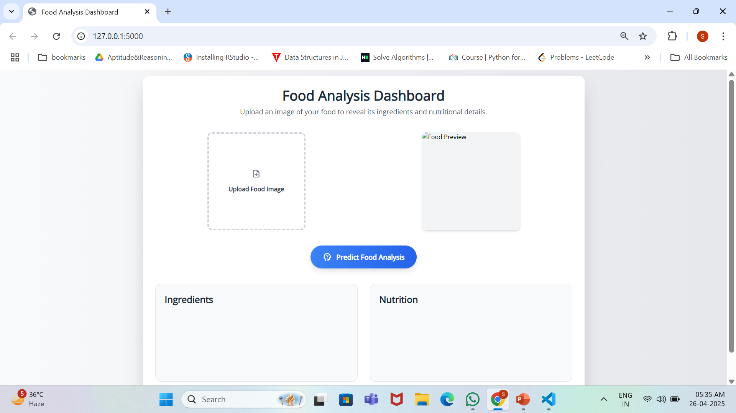
Expected output :

Slide 20
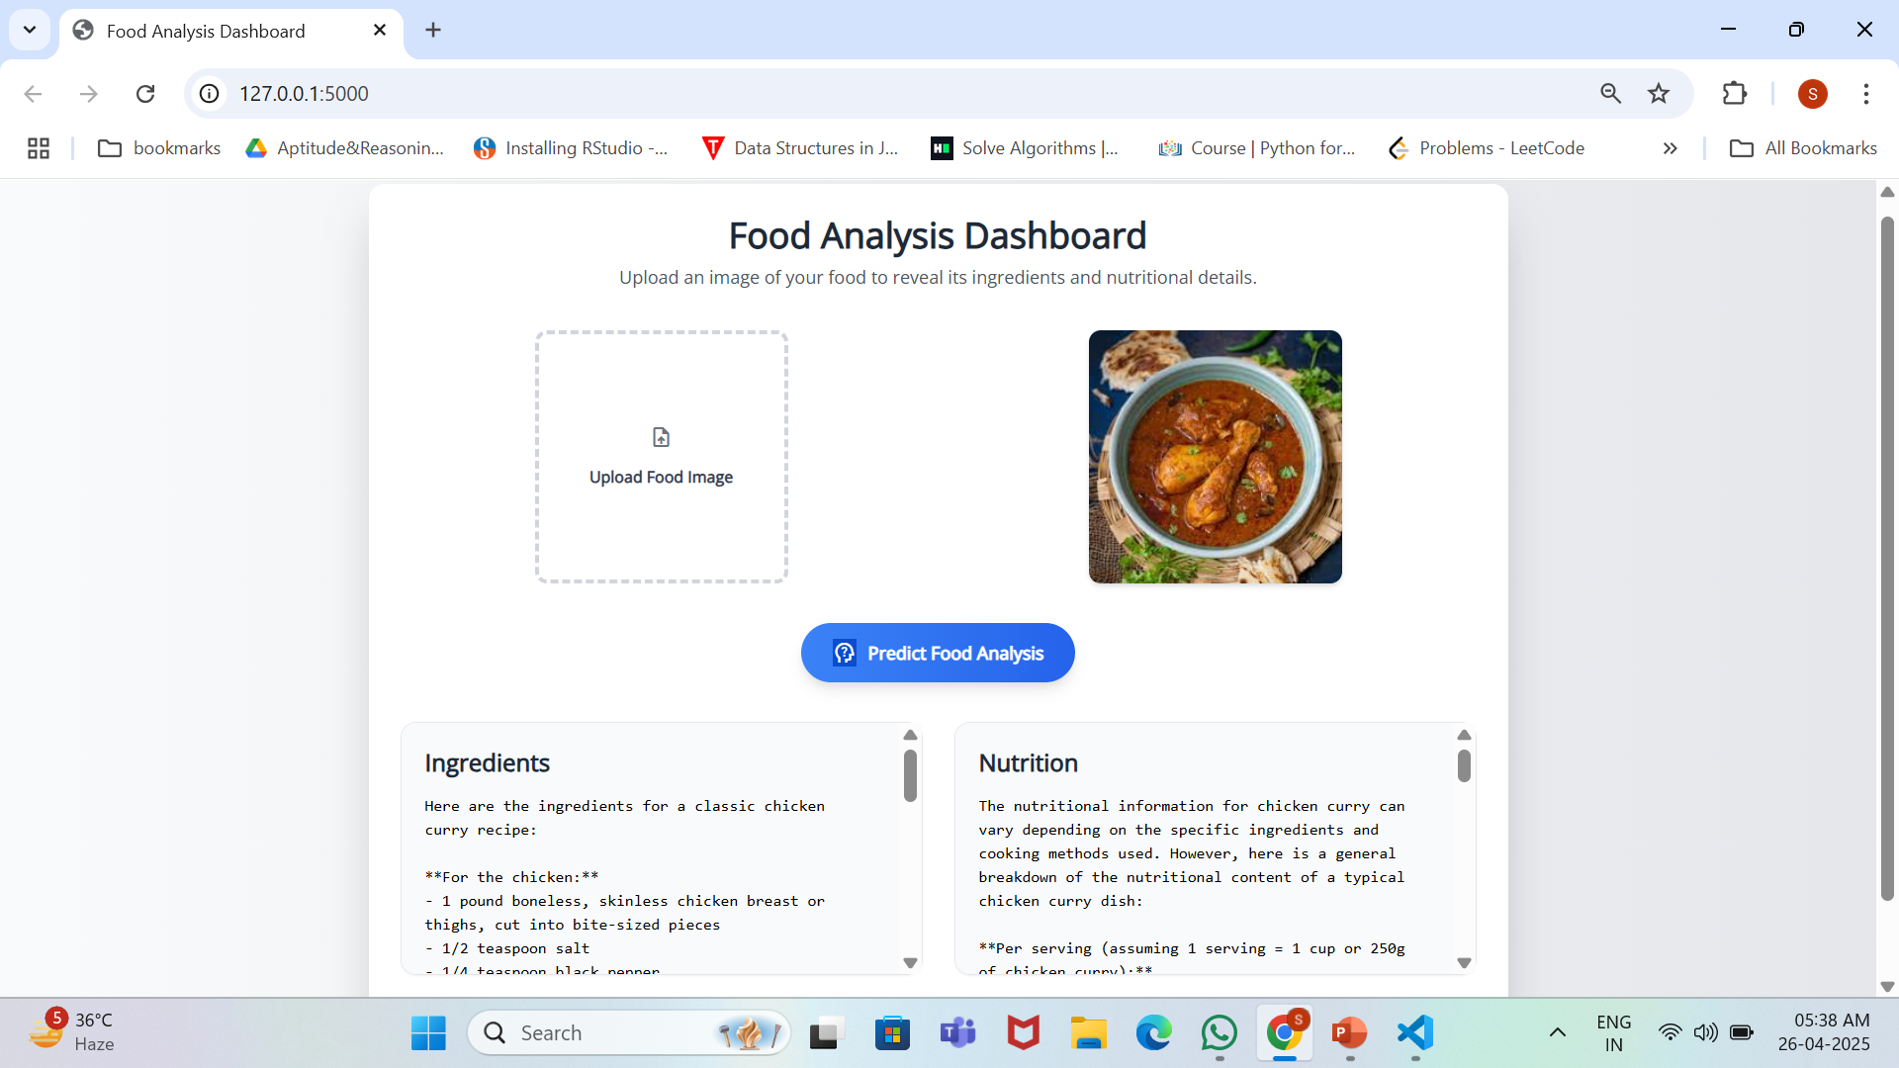

Slide 21
Conclusion:
This project demonstrates the successful implementation of an end-to-end machine learning-based web application capable of classifying food items using image input. Leveraging the power of a VGG16 convolutional neural network, the system accurately predicts one of 101 food categories from the Food-101 dataset. The application is further enriched by integrating Groq’s large language model, which adds descriptive insights by providing:
• Ingredients commonly used in the predicted dish
• Nutritional content for user awareness
The system features a responsive user interface, reliable backend inference, and informative API integration, offering a comprehensive food recognition and information tool. Through extensive testing, the model has shown high prediction accuracy, resilience to invalid input, and user-friendly error handling.

Slide 22
Future work:
• Allergen Detection: Automatically highlight common allergens from ingredients for health-sensitive users.
• Calorie Tracker: Integrate with fitness apps to track daily nutritional intake.
• Recipe Generation: Use Groq or similar APIs to provide step-by-step recipes for predicted dishes.
• User Feedback Loop: Implement a system where users can correct wrong predictions and retrain the model.

Slide 23
References:
Research Papers & Books:
Simonyan, K., & Zisserman, A. (2015). Very Deep Convolutional Networks for Large-Scale Image Recognition. International Conference on Learning Representations (ICLR).
https://arxiv.org/abs/1409.1556
Bossard, L., Guillaumin, M., & Van Gool, L. (2014). Food-101 – Mining Discriminative Components with Random Forests. ECCV 2014. https://data.vision.ee.ethz.ch/cvl/datasets_extra/food-101/
Groq Cloud API Documentation – API documentation for integration with LLMs to fetch food descriptions and nutrition.
https://groq.com/
https://flask.palletsprojects.com/
https://www.tensorflow.org/api_docs/python/tf/keras
https://numpy.org/doc/

Slide 24


